Slide 1

RL project flappy bird based on
Q-learning and NEAT
PRESENTATION
Group 2

Slide 2
CATALOG
01
RL elements and policy
02
Q-learning Project
Fundamental features about the game
Code and analysis based on q-learning
03
NEAT project
04
Result analysis
Neuro-evolution of Augmenting Topologies
A better way to train the agent?

Slide 3
01
RL elements and policy
Fundamental features about the game

Slide 4
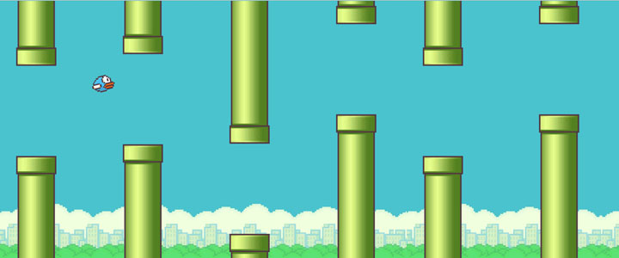
About the game:
There is a flying bird in the game. It will encounter obstacles in the pipeline during the flight. Players need to control the bird to fly upwards. During the flight, they cannot fall to the ground or touch the obstacles. If they continue to perform actions, they will fly higher and higher; if not, it will descend quickly.

Slide 5
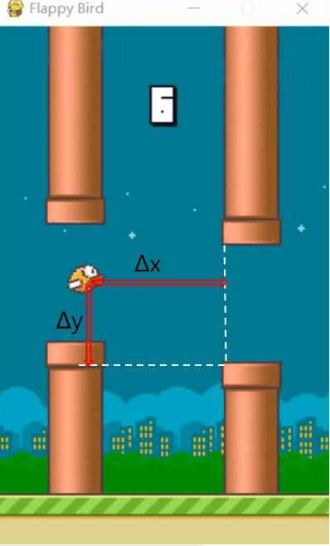
STATE
State space
Specific implementation method
Each horizontal distance and vertical distance form a two-tuple, which can show the state of the agent
Dead
Or
Alive?
How many states?
Based on the game mechanics, the coordinate will change 4 units in every frame.
(max(Δx)-min(Δx))*(max(Δy)-min(Δy))/16

Slide 6
Action and Reward
Jump or not jump
Reward
If in a certain state, the agent chooses to jump and give the bird an upward speed.
Without jumping, the bird will fall at a constant acceleration with gravity.
Our idea is to add 1 point to the score of the bird if the bird does not die after each status update, and deduct many points if the bird dies.

Slide 7
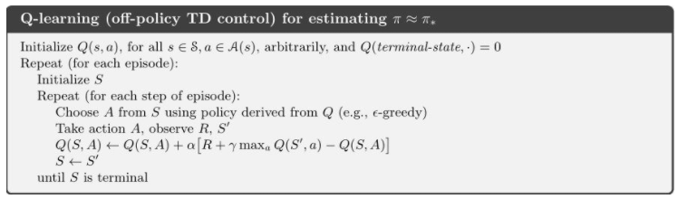
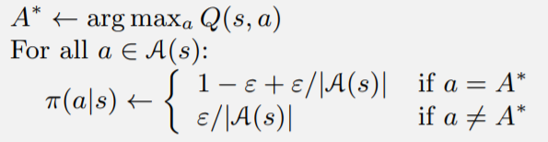
How to find the optimal policy

Slide 8
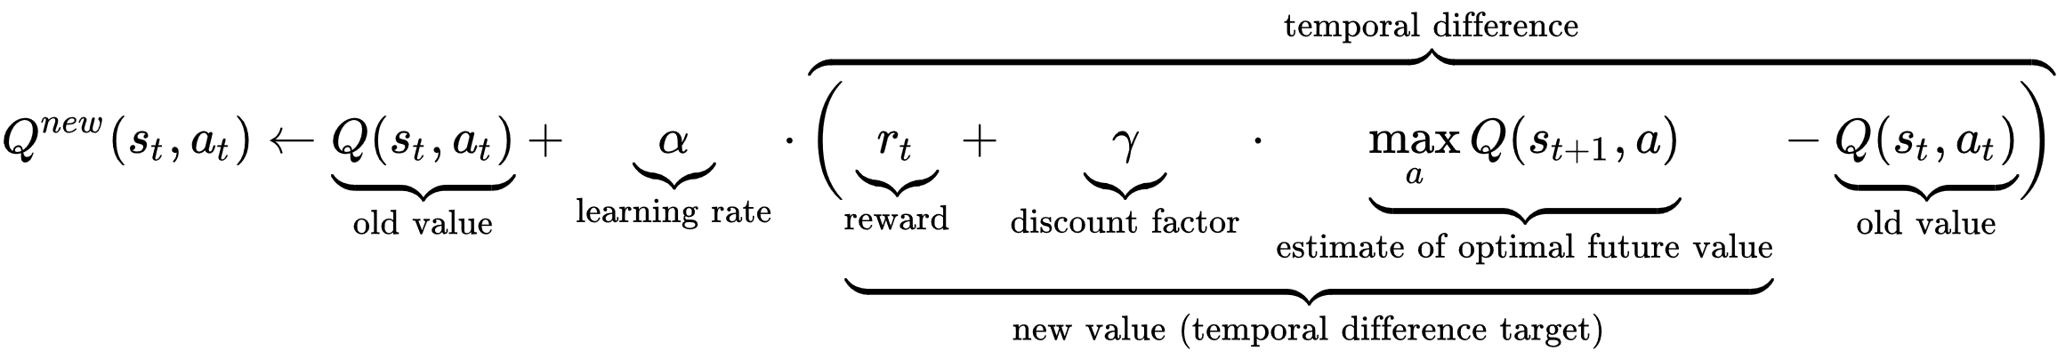
Some explanations about the parameters:
The learning rate (0~1) or step size determines to what extent newly acquired information overrides old information.
The discount factor (0~1) determines the importance of future rewards.

Slide 9
02
Q-learning Project
Flappy Bird Based On Q-learning

Slide 10
Project modules
01
flappy.py
02
algorithms.py
its role is to design an environment that the agent interacting with.
its role is to update each value of the Q-table until it reaches the convergence state.
03
evaluate_bird.py
04
test.py
it's a training process,circulating thousands of episodes to get the final Q-table.Besides,it needs to record the score of each episodes and count the average score in every series to show the training result in form of a line chart.
it's finally pickaged game,
which uses the final Q-table as agent's policy.

Slide 11
Module:flappy.py
class: FlappyBird
FPS
_LIST
score
deltax/delty
playerx/playery
num_states
num_actions
lowerPipes
crashTest
SCREENWIDTH/
SCREENHIGHT
pipeVelX
playerVelY
lookup()
reset()
next()
init()
is_terminal()
main()

Slide 12
Module: Algorithms.py
Func:q-learning()
flappy.py
initialize
state0
evn.reset()
policy
ε-greedy()
loop
evn.is_terminal()
s',r=evn.next()
NO
a=choose_from_policy()

Slide 13
Module: evaluate_bird.py
algorithms.py
result.png
Func:evaluate_learning()
final Q-table
initialize
series_size
num_series
gamma
YES
loop
Func:q_learning()
alpha
episode<series_size*num_series
Q-table
epsilon
save.npy

Slide 14
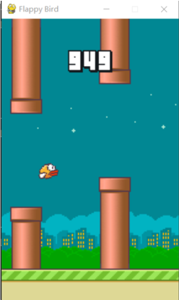
Result analysis
test.py: use the trained Q-table to play the game in an episode, the result is
as following figure shown:
所有省份可任意编辑
您的内容打在这里，或者通过复制您的文本后，在此框中选择粘贴，并选择只保留文字。您的内容打在这里，或者通过复制您的文本后，在此框中选择粘贴，并选择只保留文字。
您的内容打在这里，或者通过复制您的文本后，在此框中选择粘贴，并选择只保留文字。
After 5000 times training the brid can already get very high score and it can survive to the ·end of the game interface width.

Slide 15
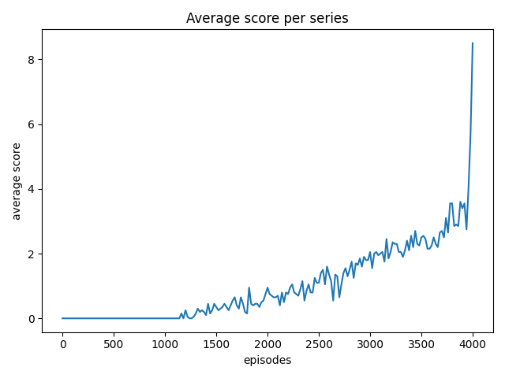
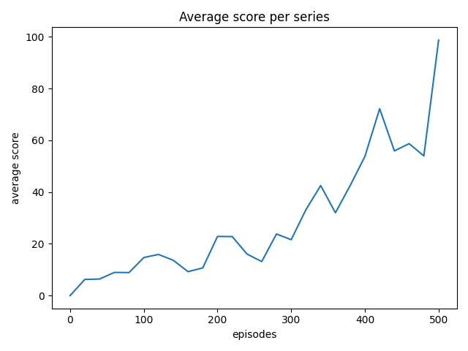
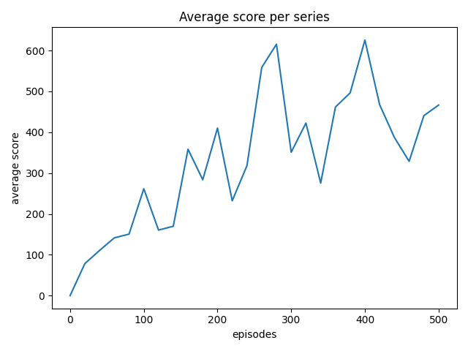
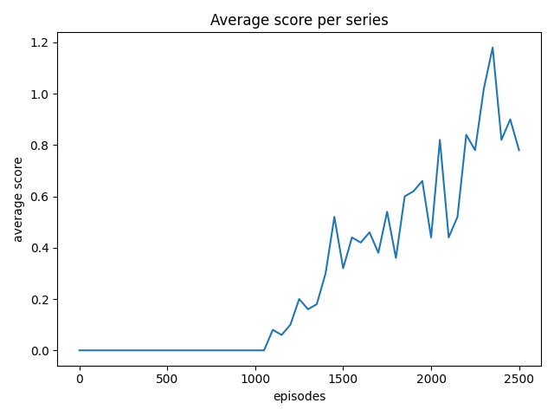
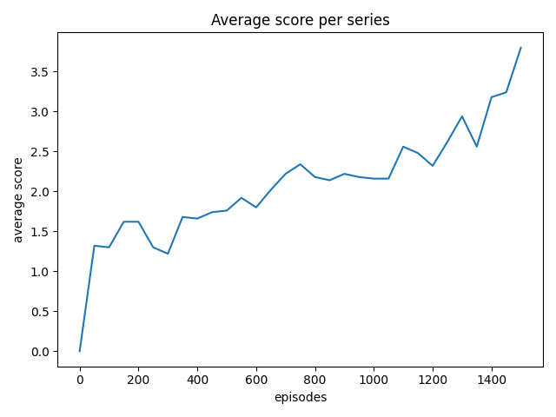
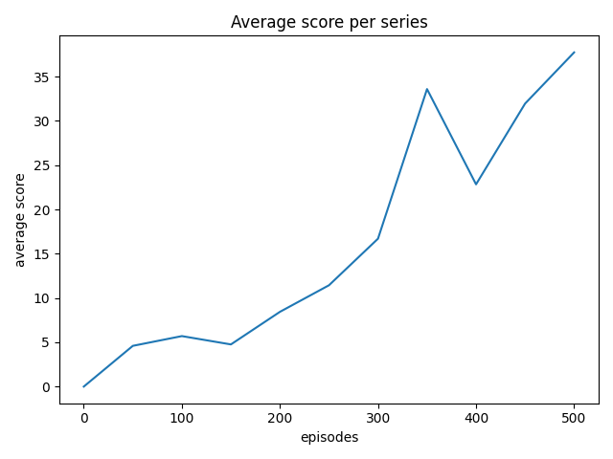
Result analysis
GAPSIZE=150 PIPEVELX=-4
GAPSIZE=100 PIPEVELX=-4

Slide 16
Result analysis
Compared with playing games manually, the scores of people playing games show randomness,and people have advantage in the beginning, but AI can get higher score by training constantly.

Slide 17
03
NEAT project
Neuro-evolution of Augmenting Topologies

Slide 18
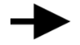
NEAT
NeuroEvolution of Augmenting Topologies (NEAT) :
A genetic algorithm for the generation of evolving artificial neural networks.
Many individuals.
Compete, eliminate, reproduce ,mutate.
(selection) (crossover) (mutation).
generation i
generation i+1

Slide 19

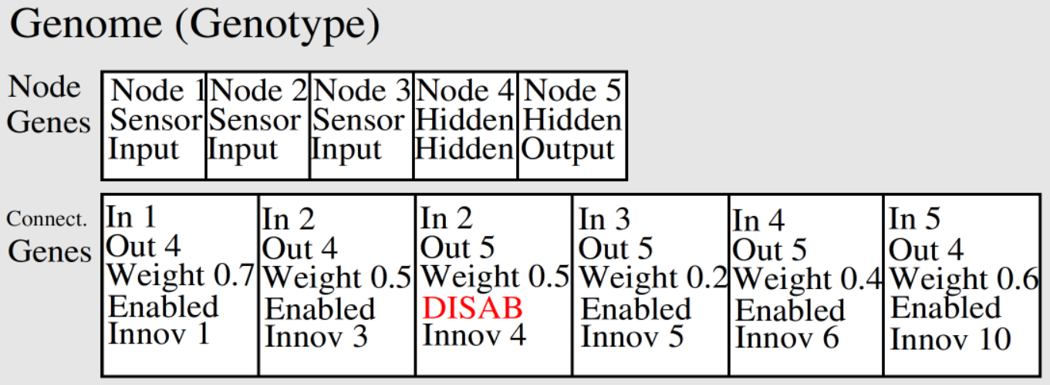
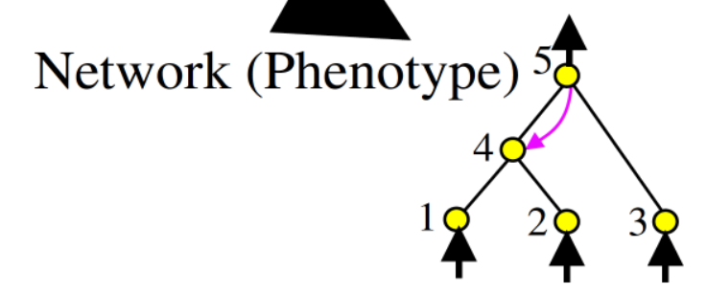
NEAT
Combining genetic algorithm with neural network.
Neural network
Genome

Slide 20
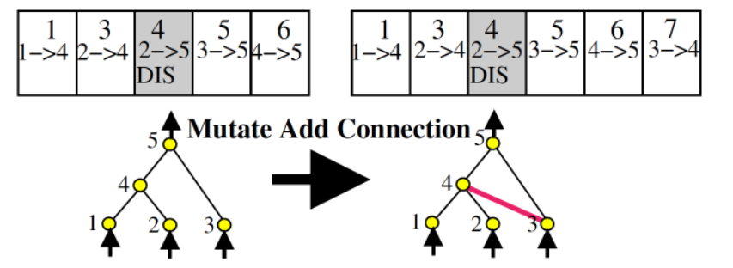
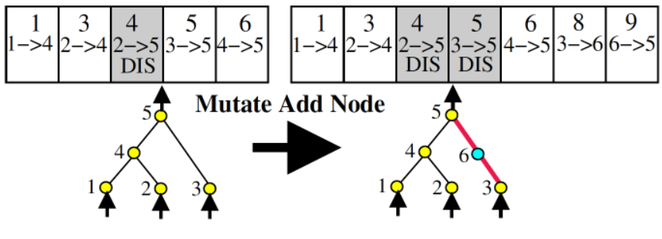
Mutation
There are 3 ways for mutation.
adding or deleting a node.
adding or deleting a connection.
changing weight within a certain range.
One more disabled record.

Slide 21
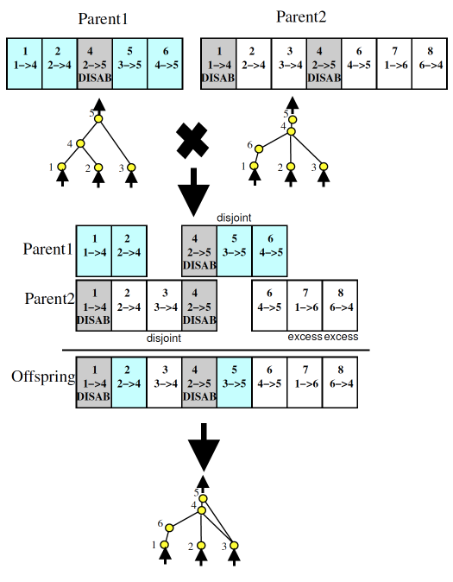

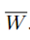
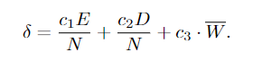
Crossover
Reproduction----crossover
Aligned by innovation ID.
Randomly selected at the same location.
Disjoint genes: (whose number is D )
The other parent has the node but not the connection.
Excess genes: (whose number is E )
The other parent does not have the node.
compatibility distance δ
is the average weight differences of matching genes.

Slide 22
Protecting Innovation with Speciation
（potential ↑ fitness ↓)
Problem:
new
δ :
Compete within species:

Slide 23
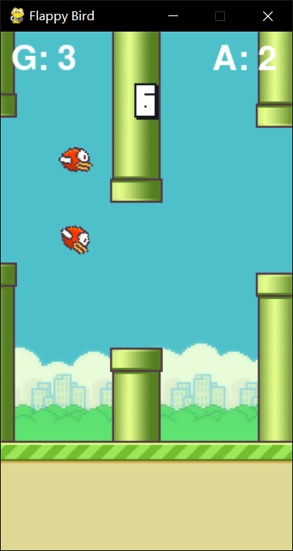
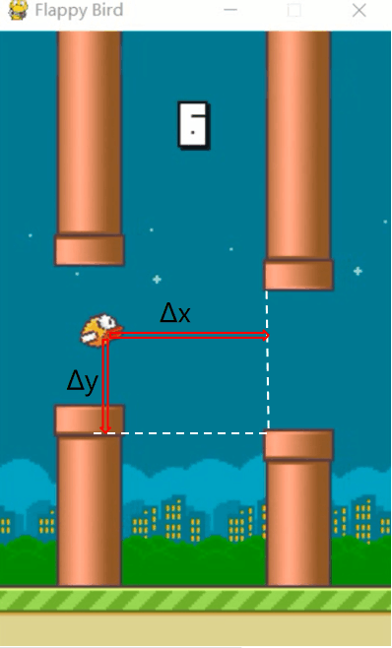
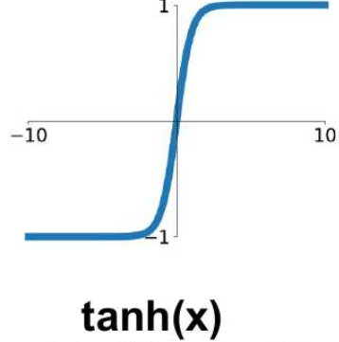
How do I apply the NEAT
>0.5: jump
x
T
A
L
b
bias
<0.5: not jump

Slide 24
How do I apply the NEAT
may change
Best

Slide 25
System
Visualization module
NEAT module
Class: Bird
Class: Pipe
Class: Base
Func: …
Configuration.txt
Func: evaluate_genomes
Func: run

Slide 26
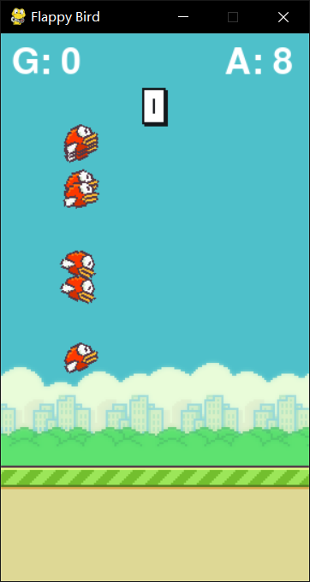
Func: evaluate_genomes
input
Mian of game
convert
Genome list
net list
decide
Bird list
Pipe list
Base
Reward = fitness of genome ：about score
output
Genome.fitness

Slide 27
Func: run
Configuration.txt
initialize
Genome list
NEAT
loop
selection
crossover
Func: evaluate_genomes
mutation
Visualization

Slide 28
04
NEAT project
NeuroEvolution of Augmenting Topologies

Slide 29
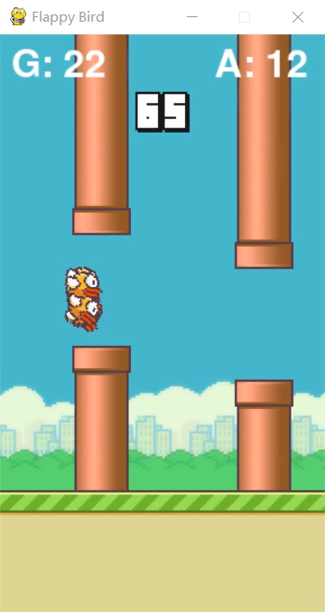
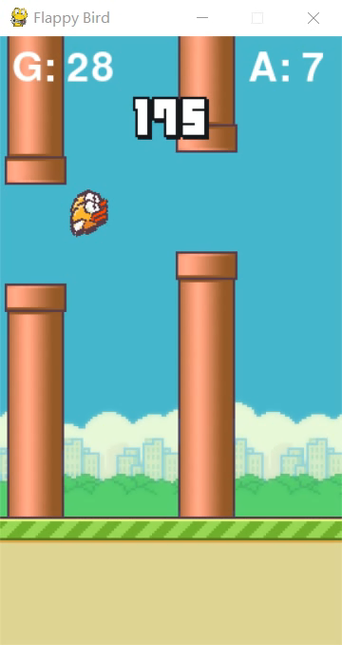
Training
more difficult game
With the help of my teammate Qin, we improved the difficulty of the game. For example, we increase the randomness of the gap position between the upper and lower pipes and appropriately reduce gap size.
This is the process of training.

Slide 30
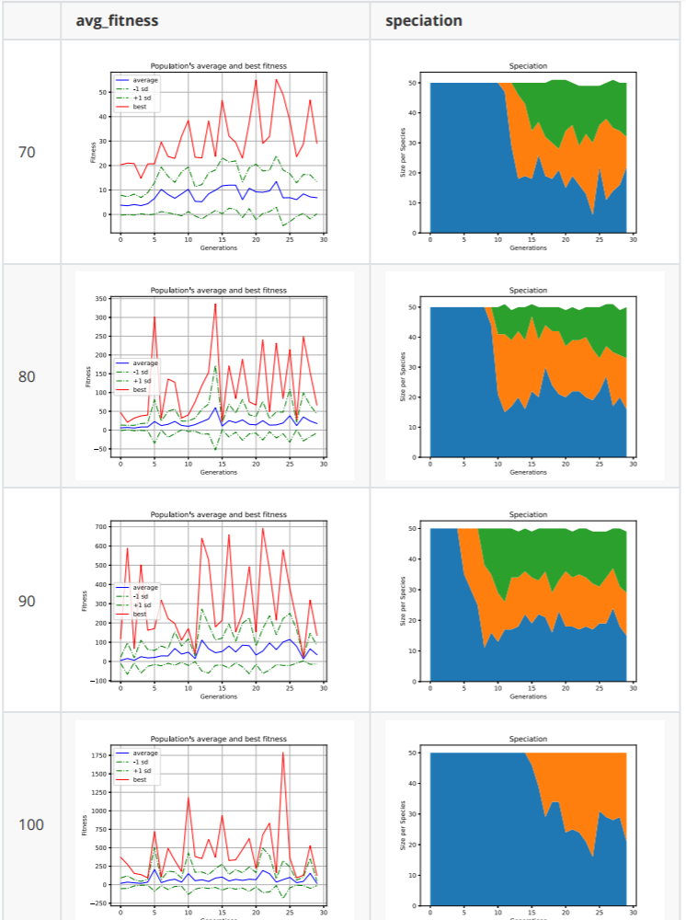
Result 1
Description:
The following content shows the performance of Flappy Bird based on NEAT algorithm at different latitudes.
Here we control for the same other variables, looking at the performance of the obstacle gap for the bird over the obstacle

Slide 31
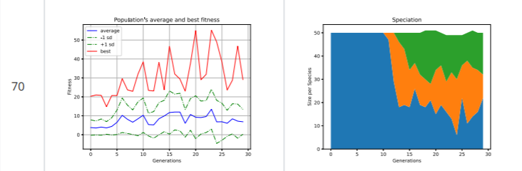
Result 1
Two ways：Mutation adds node or connection.
If a mutation node is added to the original connection, the original connection will be disabled.

Slide 32
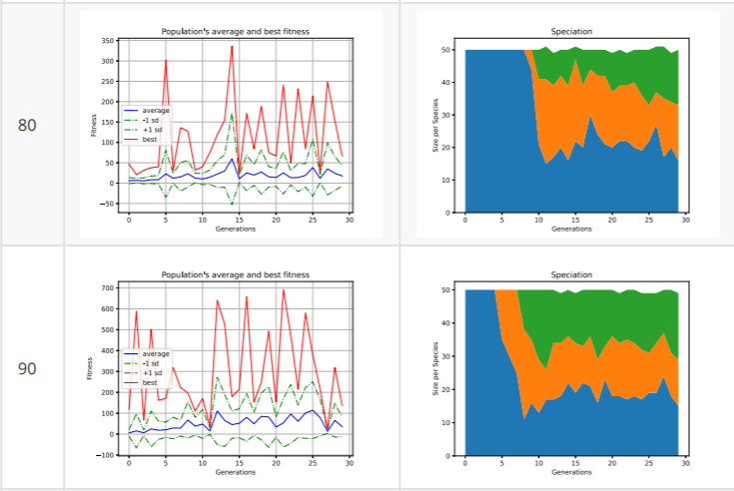
Result 1
Two ways：Mutation adds node or connection.
If a mutation node is added to the original connection, the original connection will be disabled.

Slide 33
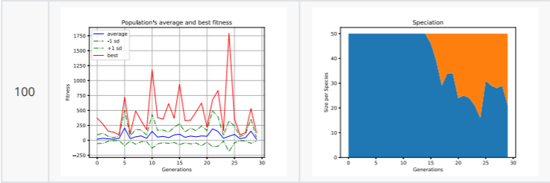
Result 1
Two ways：Mutation adds node or connection.
If a mutation node is added to the original connection, the original connection will be disabled.
Vertical comparison shows that the strategy of simply increasing the gap value reduces the difficulty of implementation, which can make neat_Flappy_bird's performance get better and better, and its fitness degree is also greatly improved

Slide 34
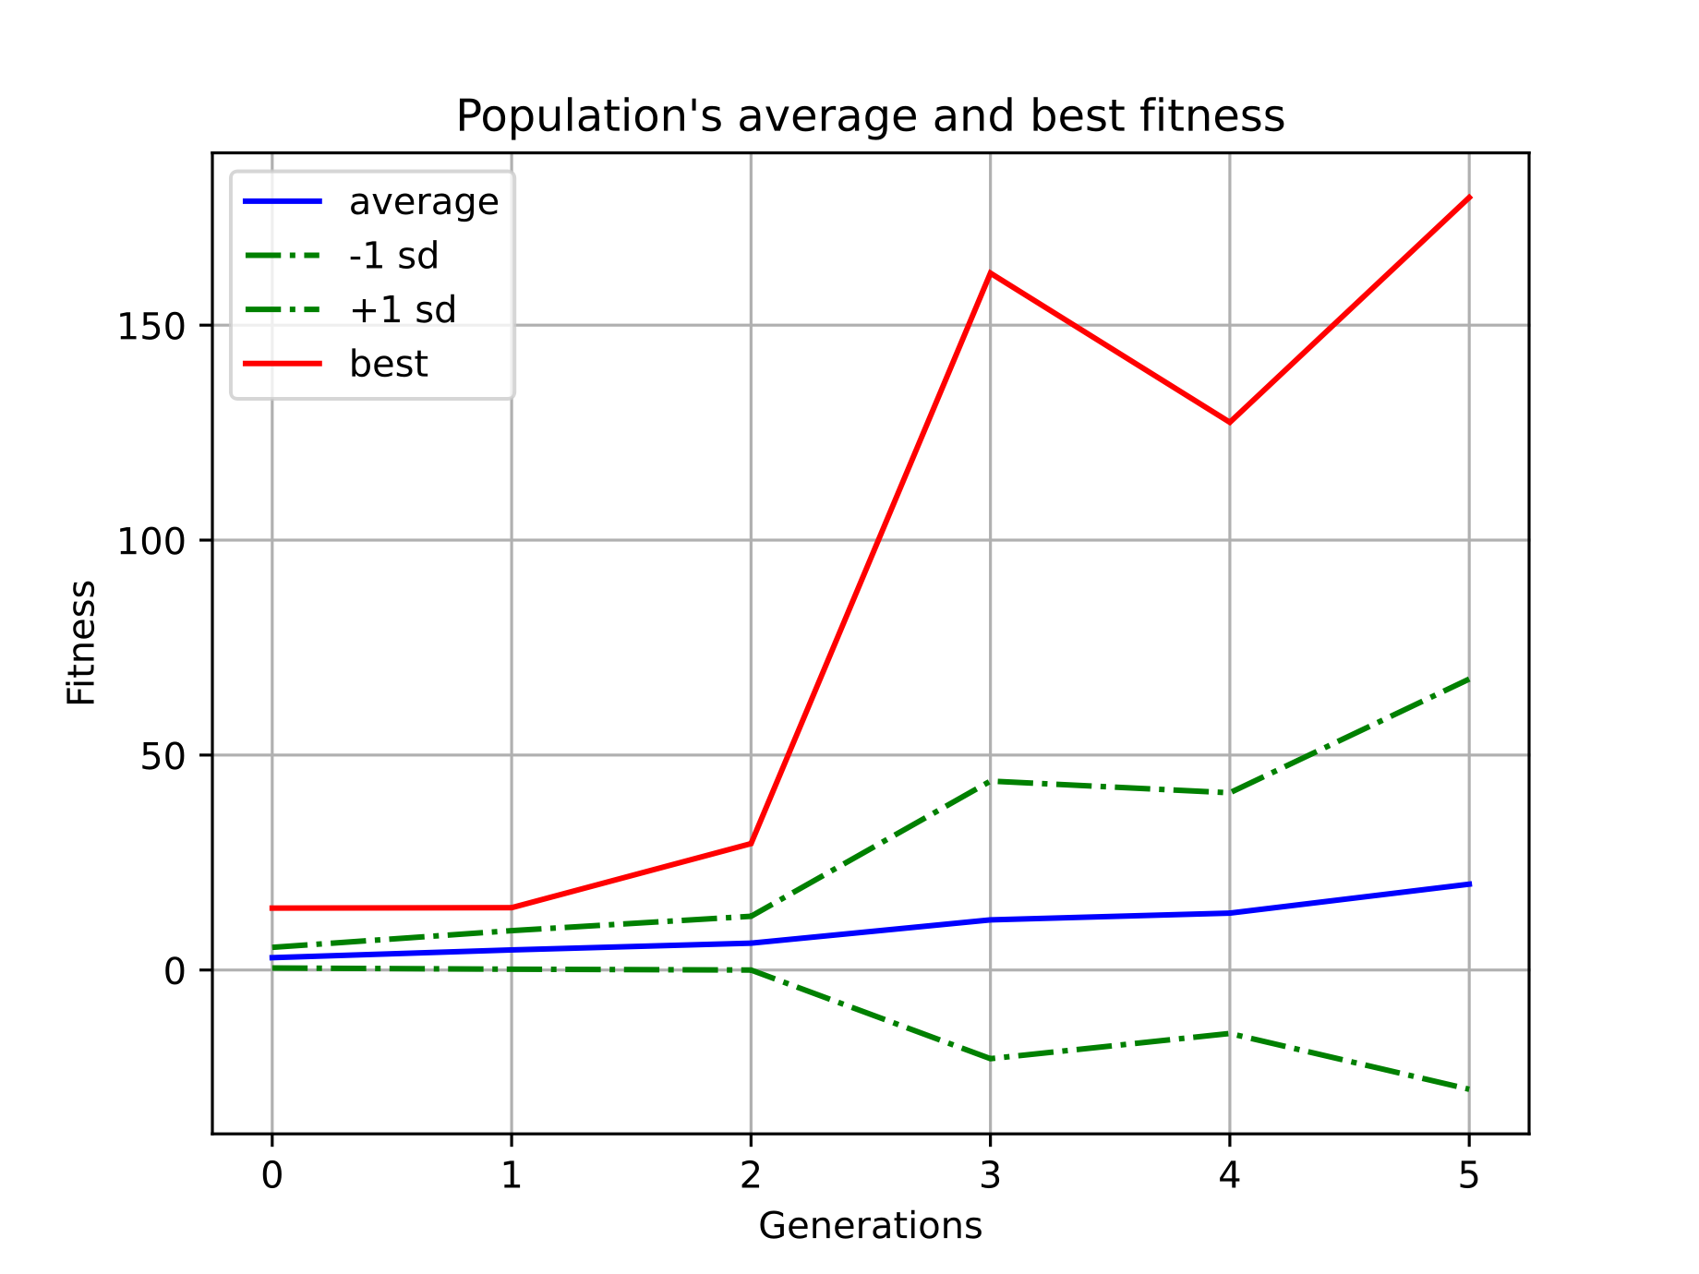
Result 1

Slide 35
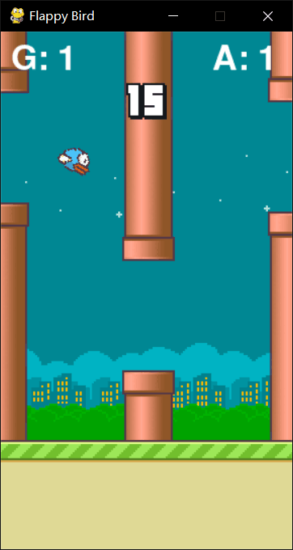
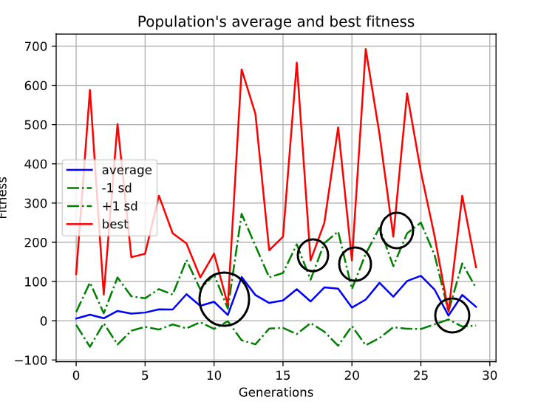
Result 1

Slide 36
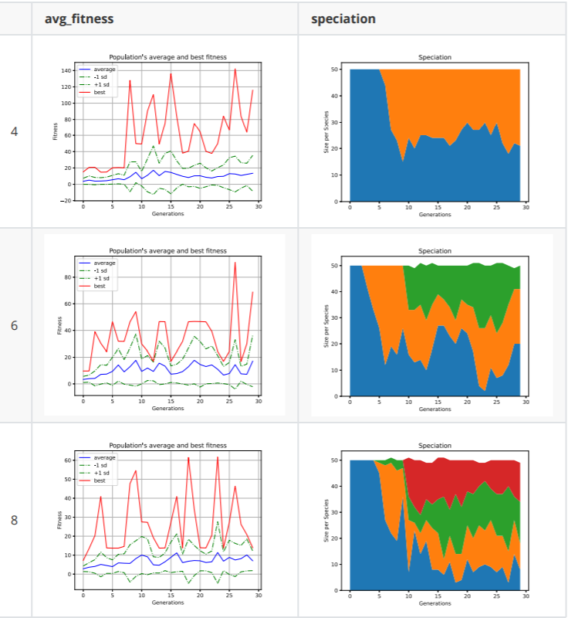
Result 2
So we studied the bird representation based on the relative speed of the bird and the obstacle, to explore at what speed the bird can learn to avoid the obstacle as intelligently as possible.

Slide 37
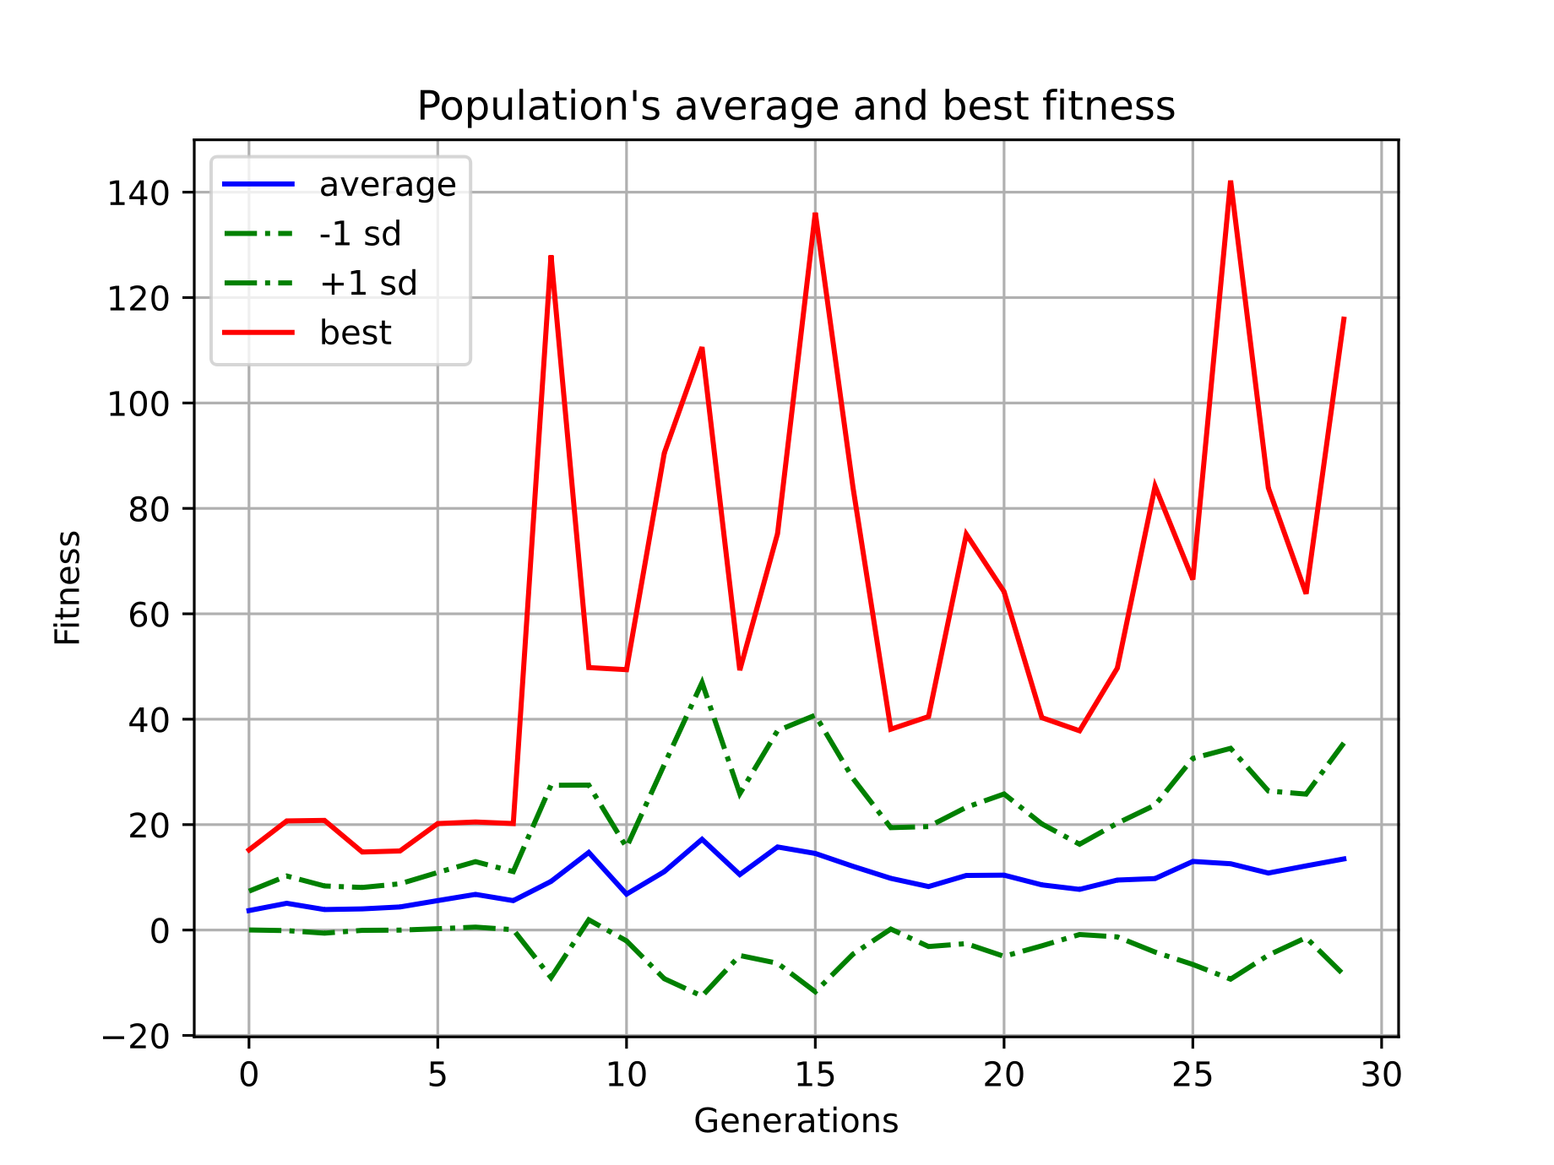
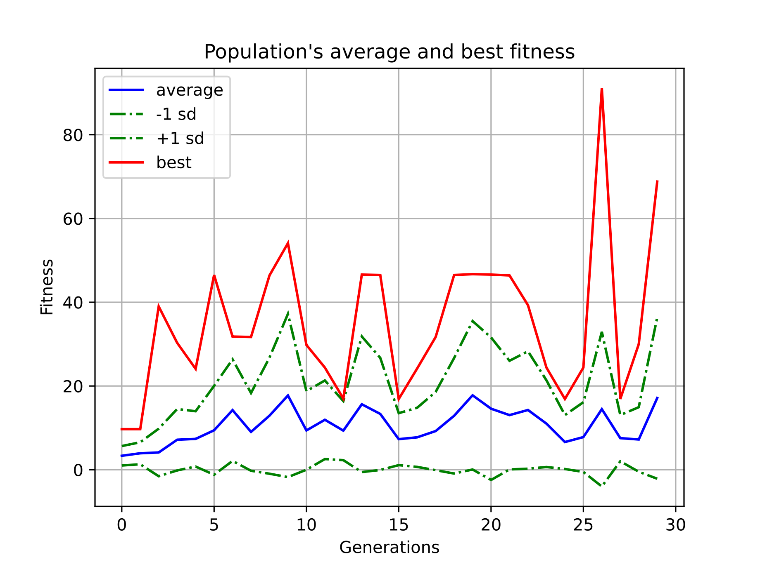
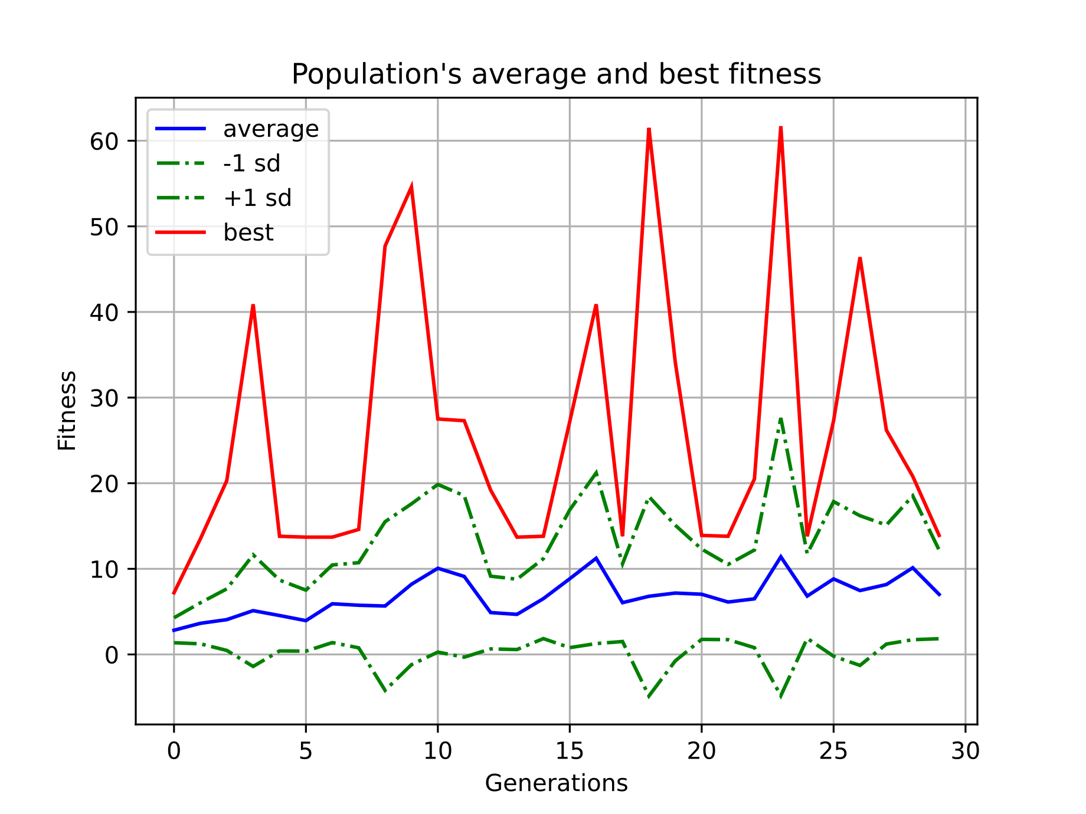
Result 2
Two ways：Mutation adds node or connection.
If a mutation node is added to the original connection, the original connection will be disabled.

Slide 38
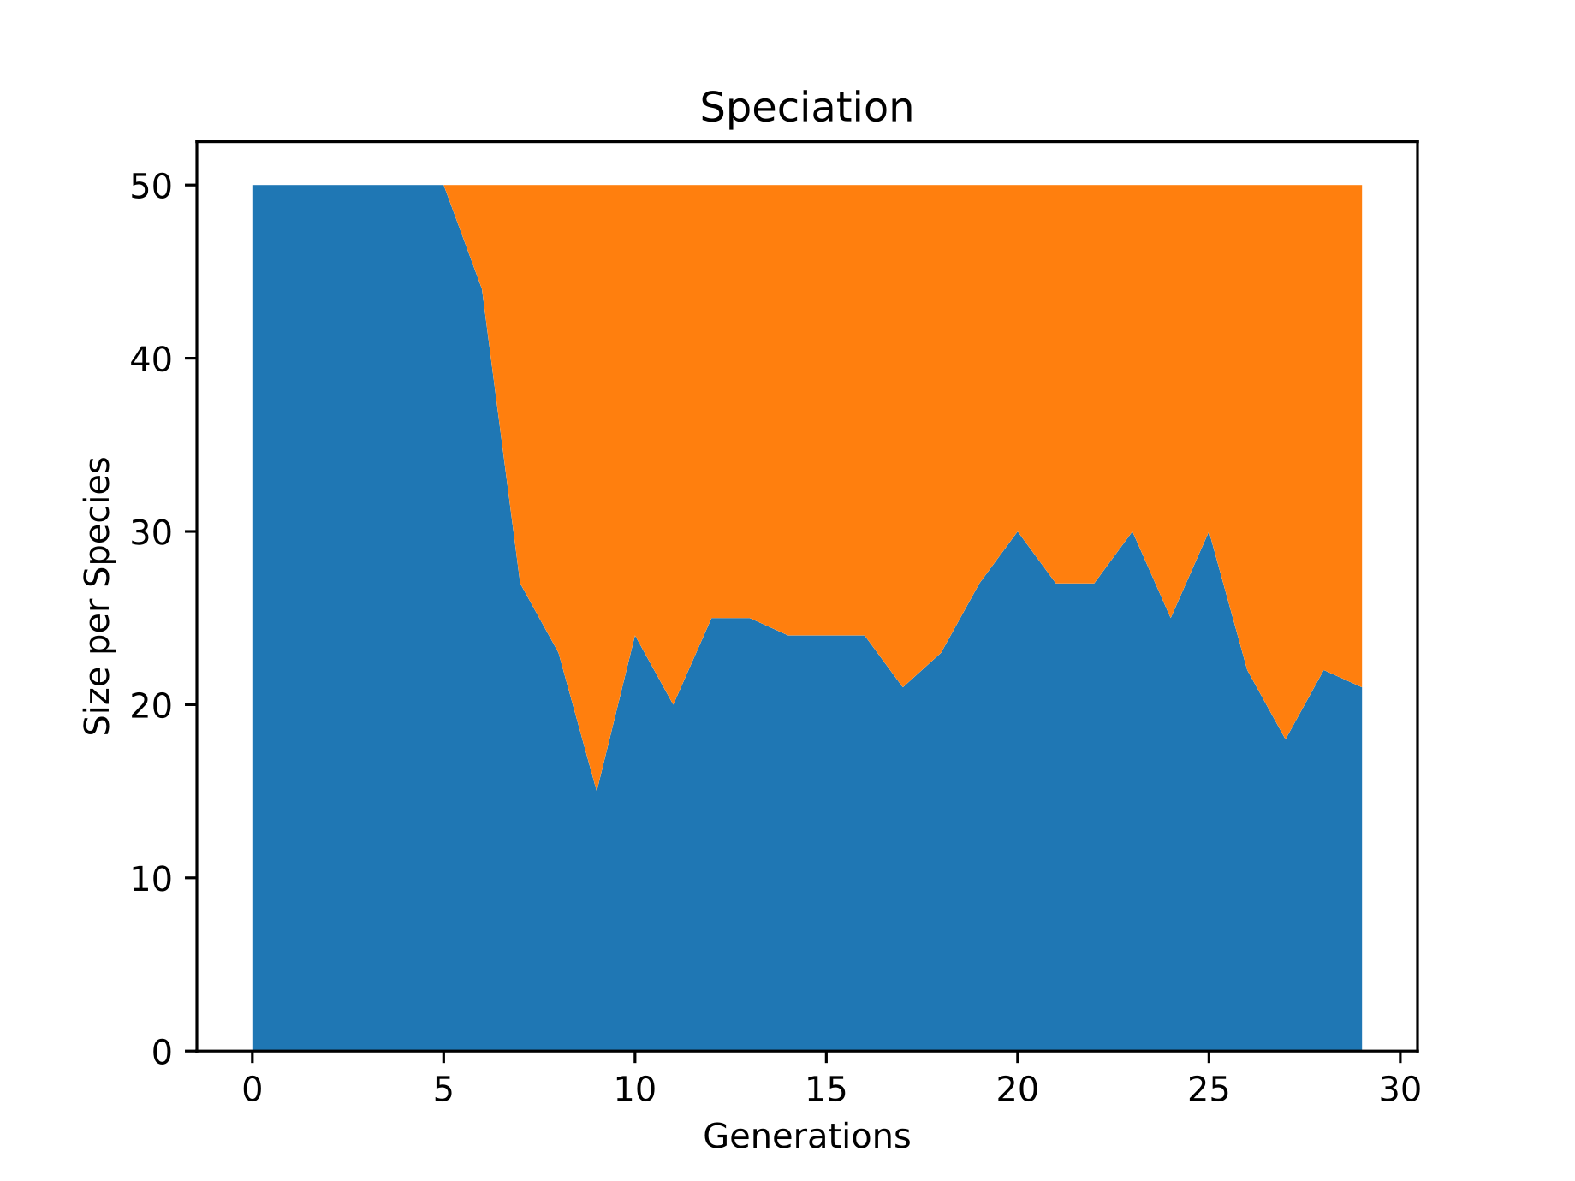
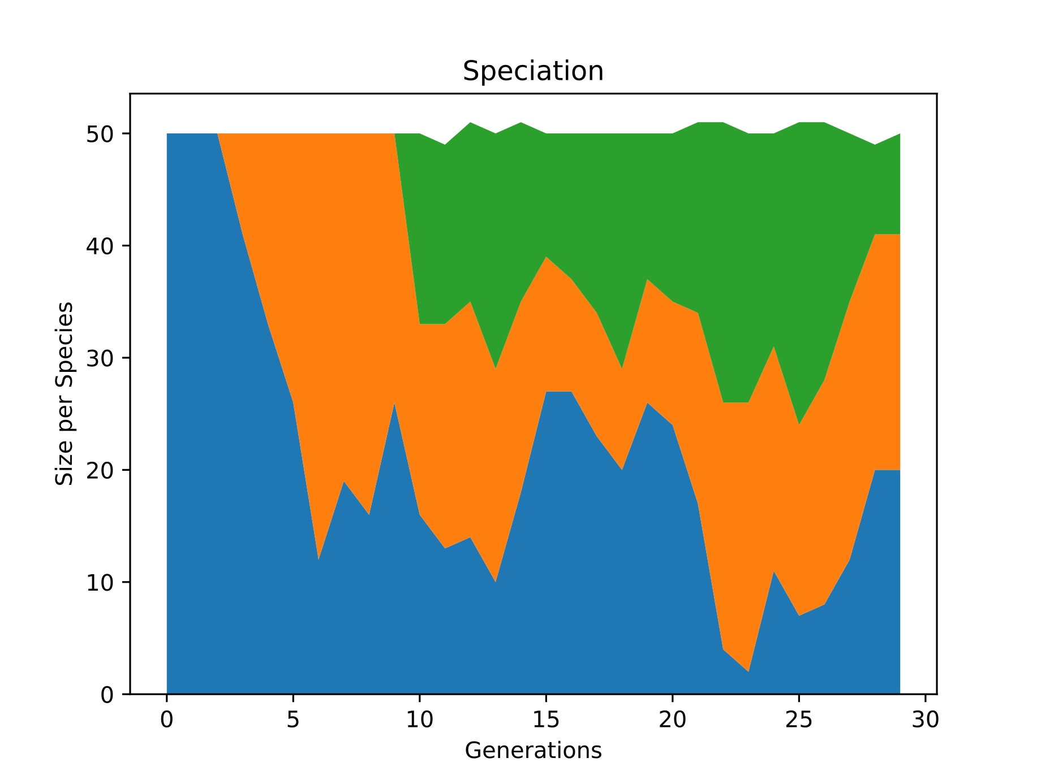
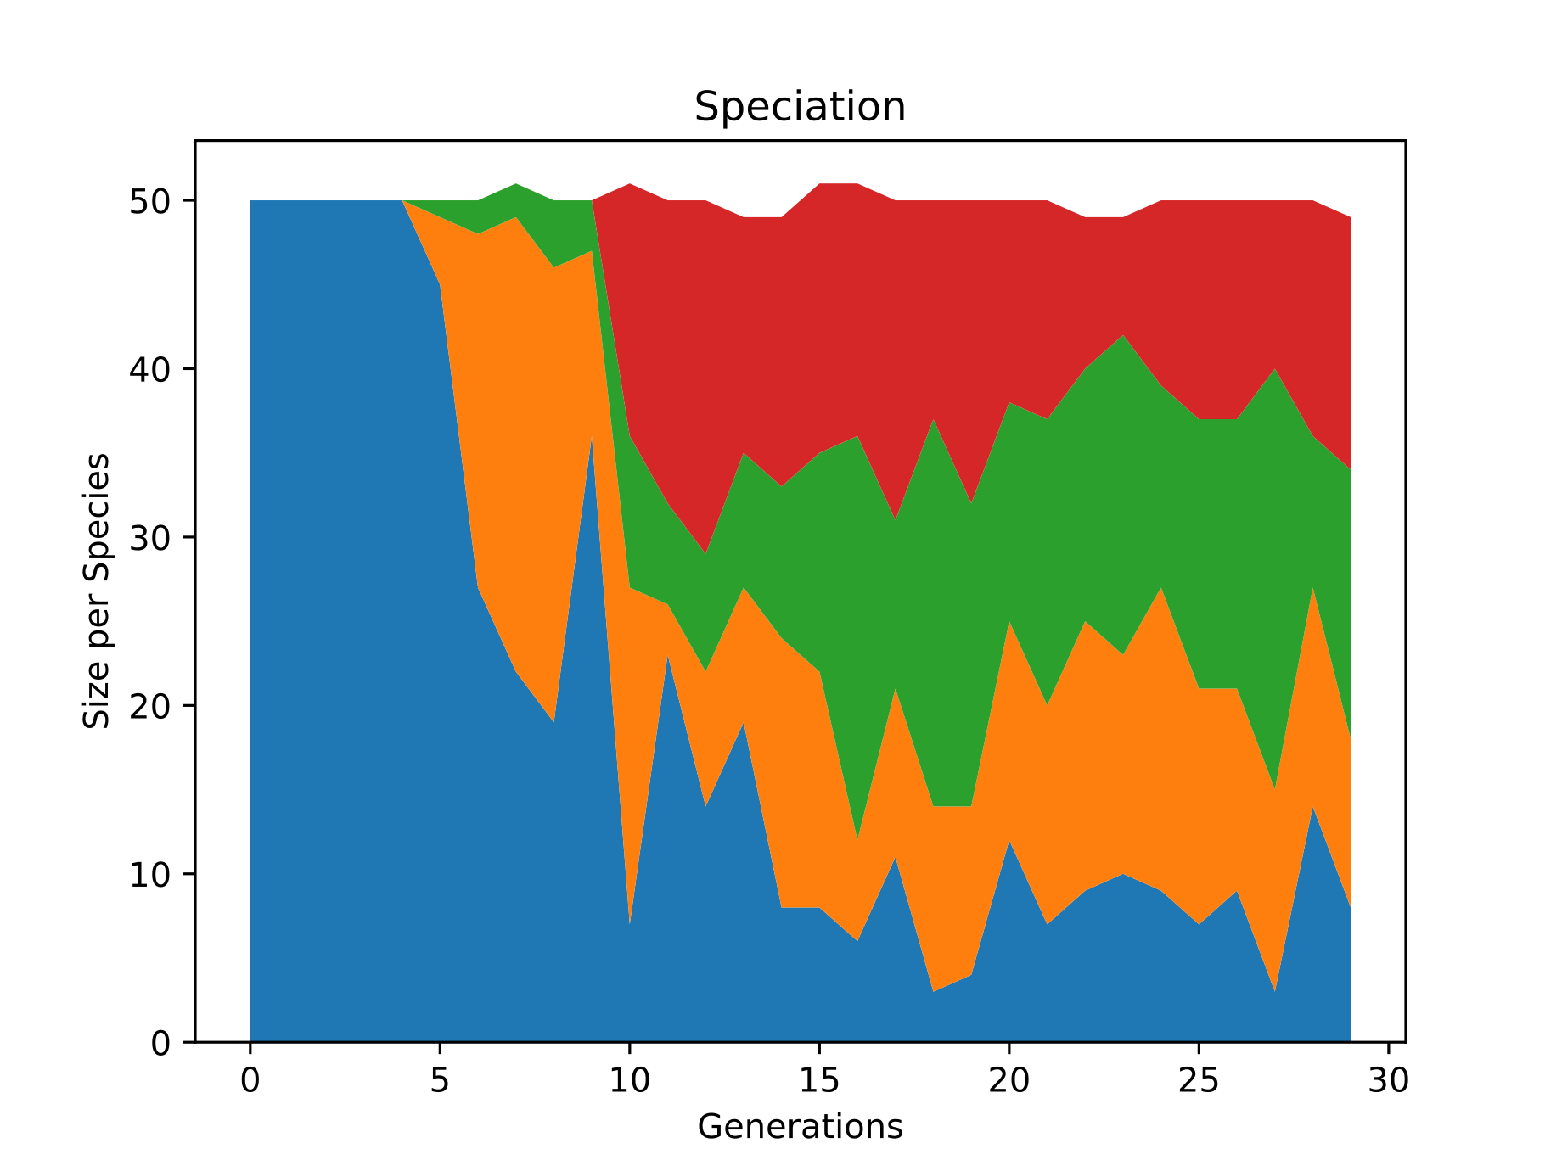
Result 2 -- SPEED
6
4
We found that as the difficulty increased, more species appeared, and more patches of color appeared on the diagram. That is to say, the increase of difficulty promotes the occurrence of mutation, and the proportion of species obtained by new mutation also increases.

Slide 39
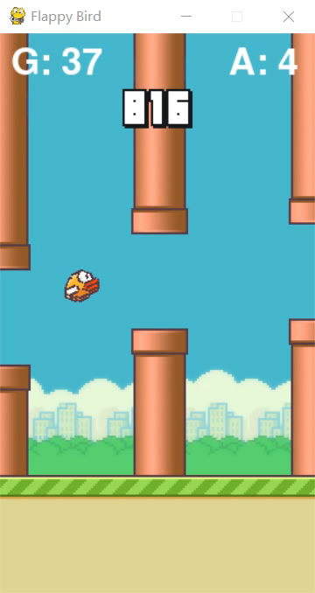
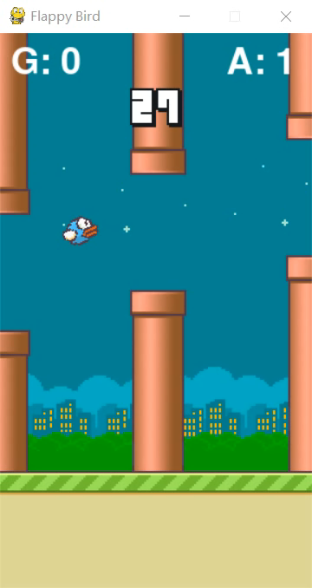
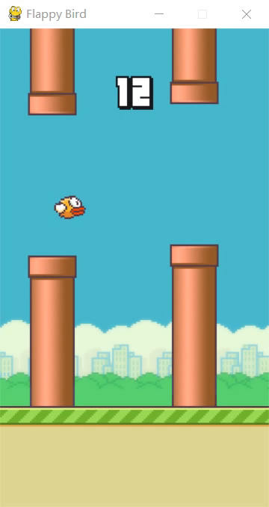
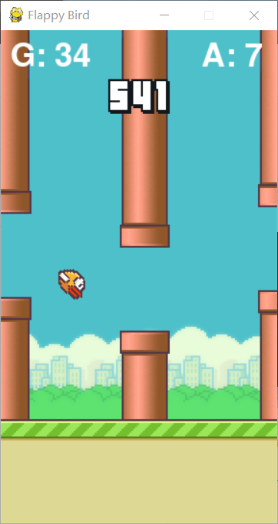
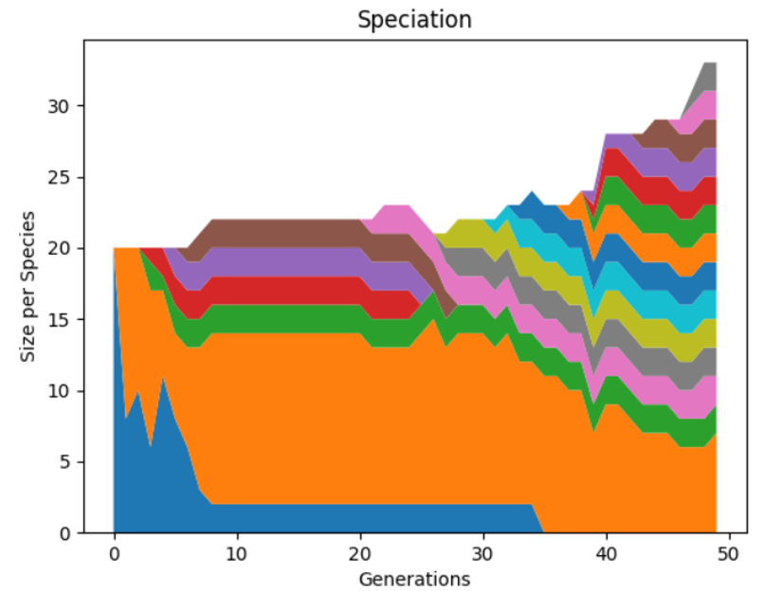
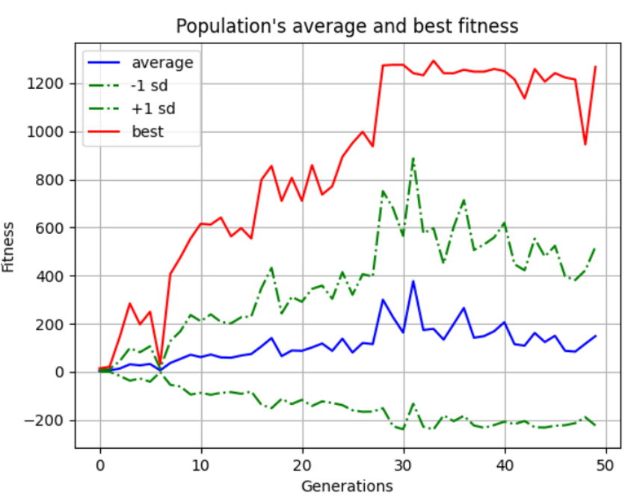
Final result

Slide 40
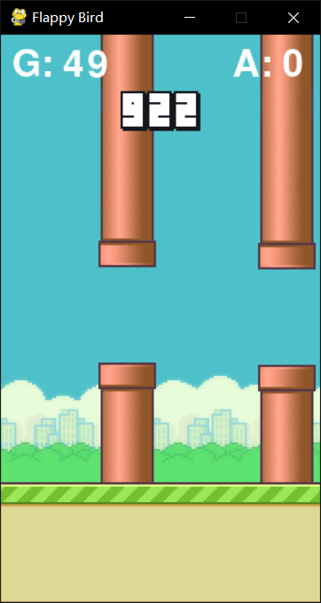
Thank you
Presentation by Group 2
Flappy bird

Slide 41
Thank you
Presentation by Group 2
Flappy bird

Slide 42
Thank you
Presentation by Group 2
Flappy bird

Slide 47
RL project flappy bird based on
Q-learning and NEAT
PRESENTATION
Group 2

Slide 48
CATALOG
01
RL elements
02
Optimal policy
Extract features based on the game itself
How to find the optimal policy
03
NEAT
04
….
….
….

Slide 49
01
RL elements
Extract features based on the game itself

Slide 50
STATE
State space
Too many states?
The horizontal distance of the bird from the next pipe.
The vertical distance of the bird from the next pipe.
Birds die or live.
We know that every time the bird or pipe moves, it is not every time the coordinates + 1 or -1, but + 4 or – 4, which will greatly reduce the number of states.
We consider that not every frame is detected to reduce the amount of computation.
We consider discretizing the distance. This will be a subsequent optimization of our original version.

Slide 51
Action and Reward
Reward
Jump or not jump
If in a certain state, the agent chooses to jump and give the bird an upward speed.
Without jumping, the bird will fall at a constant acceleration with gravity.
We have two schemes.
One is to add 1 point to the score of the bird if the bird does not die after each status update, and deduct many points if the bird dies. Another option is to give a score after the bird dies. The score is the number of tubes the bird passes through.
We think that the first scheme updates the reward immediately, but it may have high computational complexity, and the second scheme delays updating the reward, which may take a long time to train.

Slide 52
Action and Reward
Reward
Jump or not jump
If in a certain state, the agent chooses to jump and give the bird an upward speed.
Without jumping, the bird will fall at a constant acceleration with gravity.
We have two schemes.
One is to add 1 point to the score of the bird if the bird does not die after each status update, and deduct many points if the bird dies. Another option is to give a score after the bird dies. The score is the number of tubes the bird passes through.
We think that the first scheme updates the reward immediately, but it may have high computational complexity, and the second scheme delays updating the reward, which may take a long time to train.

Slide 53
How to find the optimal policy
Each time an action is taken, a new status and reward will be generated. Update the q-table according to the following formula, and then select the action according to the updated q-table next time. In qlearning, each action is selected according to a greedy policy

Slide 54
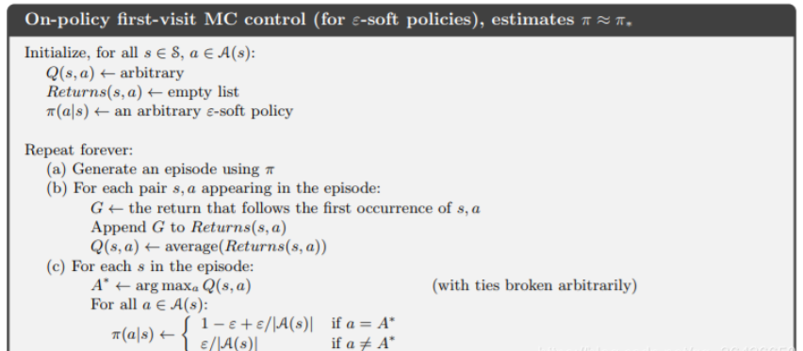
How to find the optimal policy
We assume that ε- Soft policies to determine policy

Slide 55
How to find the optimal
01
02
输入相关标题
这里输入简单的文字概述这里输入简单文字概述简单的文字概述这里输入简单的文字概述这里输入
这里输入简单的文字概述这里输入简单文字概述简单的文字概述这里输入简单的文字概述这里输入
03
输入相关标题
04
输入相关标题
这里输入简单的文字概述这里输入简单文字概述简单的文字概述这里输入简单的文字概述这里输入
这里输入简单的文字概述这里输入简单文字概述简单的文字概述这里输入简单的文字概述这里输入

Slide 56
03
NEAT project
NeuroEvolution of Augmenting Topologies

Slide 57
NEAT
NeuroEvolution of Augmenting Topologies (NEAT) :
A genetic algorithm for the generation of evolving artificial neural networks.
Many individuals.
Compete, eliminate, reproduce ,mutate.
(selection) (crossover) (mutation).
generation i
generation i+1

Slide 58
NEAT
Combining genetic algorithm with neural network.
Neural network
Genome

Slide 59
Mutation
There are 3 ways for mutation.
adding or deleting a node.
adding or deleting a connection.
changing weight within a certain range.
One more disabled record.

Slide 60
Crossover
Reproduction----crossover
Aligned by innovation ID.
Randomly selected at the same location.
Disjoint genes:
The other parent has the node but not the connection.
Excess genes:
The other parent does not have the node.
compatibility distance δ

Slide 61
Protecting Innovation with Speciation
（potential ↑ fitness ↓)
Problem:
new
δ :
Compete within species:

Slide 62
How do I apply the NEAT
>0.5: jump
x
T
A
L
b
bias
<0.5: not jump

Slide 63
How do I apply the NEAT
may change
Best

Slide 64
System
Visualization module
NEAT module
Class: Bird
Class: Pipe
Class: Base
Func: …
Configuration.txt
Func: evaluate_genomes
Func: run

Slide 65
Func: evaluate_genomes
input
Mian of game
convert
Genome list
net list
decide
Bird list
Pipe list
Base
Reward = fitness of genome = score*10
output
Genome.fitness

Slide 66
Func: run
Configuration.txt
initialize
Genome list
loop
NEAT
Visualization
Func: evaluate_genomes

Slide 67
Neat and Visualization
Configuration.txt
initialize
Genome list
loop
NEAT
Visualization
Func: evaluate_genomes

Slide 68
04
NEAT project
NeuroEvolution of Augmenting Topologies

Slide 69
Crossover
Reproduction----crossover
Aligned by innovation ID.
Randomly selected at the same location.
Disjoint genes:
The other parent has the node but not the connection.
Excess genes:
The other parent does not have the node.

Slide 70
NEAT
NeuroEvolution of Augmenting Topologies (NEAT) is a genetic algorithm (GA) for the generation of evolving artificial neural networks.
Each genome includes two gene sets to describe how to establish an artificial neural network.
Node genes: it uniquely represents a specific single neuron.
Connect genes: it uniquely represents a single connection between specific neurons.
Key points
The innovation ID is used to directly code the nodes and connections of the neural network.
The offsprings are generated through crossover according to the innovation ID.
There are gene mutations in connections and nodes
Protecting innovation through speciation.
The initialized neural network has only input and output nodes in order to make the neural network evolve from the simplest network.

Slide 71
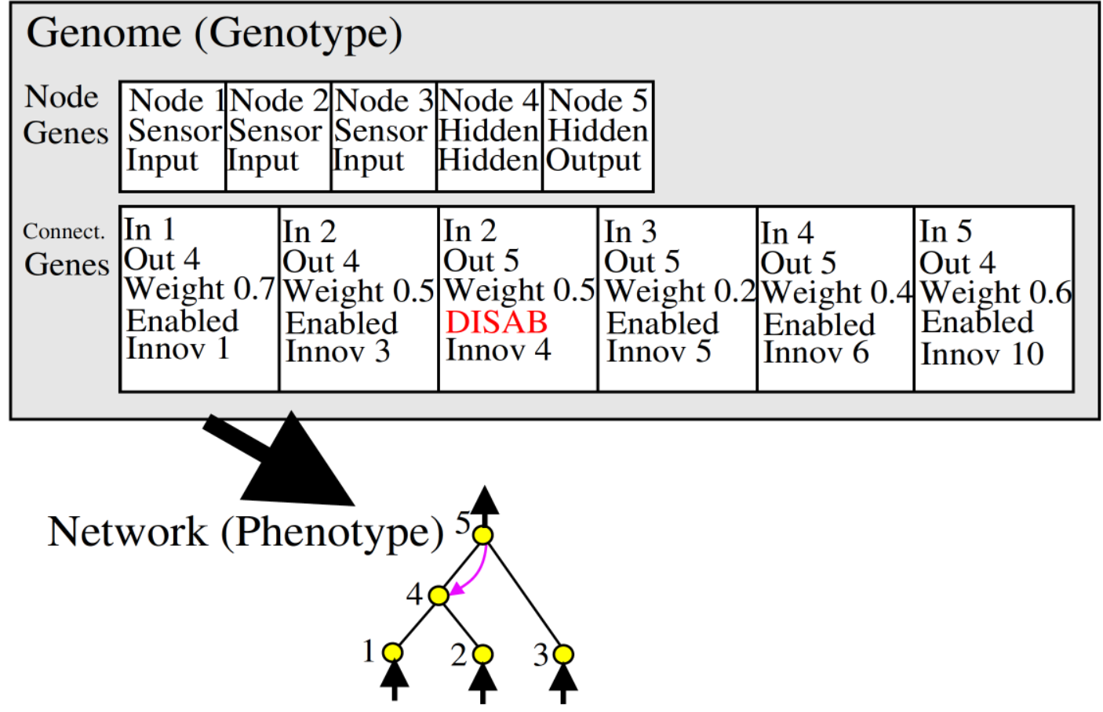
How do I apply the near algorithm
The figure shows how to represent the neural network through the genome.
Node genes is the definition of each node of the neural network. It points out the node is an input, output or hidden node.
Connect genes indicates the connection information between nodes including what nodes are associated, the weight, whether the connection is enabled or not and the exclusive innovation ID.

Slide 72

How to mutate
Two ways：Mutation adds node or connection.
If a mutation node is added to the original connection, the original connection will be disabled.

Slide 73

How to mutate and crossover
Two ways to mutate: add node or connection.
Crossover aligns the genes of parents according to innov ID and inherits them. If there are differences between the two sides in the same position, choose at random.
Notes:
If a mutation node is added to the original connection, the original connection will be disabled.

Slide 74
NeuroEvolution of Augmenting Topologies (NEAT) is a genetic algorithm (GA) for the generation of evolving artificial neural networks
01
02
03
04
添加标题
添加标题
添加标题
添加标题
完成模高和
图高的作业
争取尽快做
好不能再拖
辅助软件可以
为幻灯片提供
很好的辅助等
有必要去学习
形成思路风格
仔细考量细节
把每一步做好
这是并列关系
的表达方式之
你可以输入其
他的内容代替

Slide 75
单击添加文字标题
输入小标题
在此处输入文字对自己/公司所需人才的基本特征进行介绍。
输入小标题
在此处输入文字对自己/公司所需人才的基本特征进行介绍。
输入小标题
在此处输入文字对自己/公司所需人才的基本特征进行介绍。

Slide 76
单击添加文字标题
38%
76%
点击输入标题
点击输入本栏的具体文字，简明扼要的说明分项内容，请根据您的具体内容酌情修改。
86%
点击输入标题
点击输入本栏的具体文字，简明扼要的说明分项内容，请根据您的具体内容酌情修改。
点击输入标题
53%
点击输入本栏的具体文字，简明扼要的说明分项内容，请根据您的具体内容酌情修改。
点击输入标题
点击输入本栏的具体文字，简明扼要的说明分项内容，请根据您的具体内容酌情修改。

Slide 77
单击添加文字标题
输入文字信息
输入文字信息
输入文字信息
输入文字信息

Slide 78
02
单击添加文字标题
templateBusiness end of year job summary
general PPT template

Slide 79
单击添加文字标题
在此输入酷炫文字
在此输入酷炫文字
输入相关文字
输入相关文字
在此输入酷炫文字
在此输入酷炫文字
输入相关文字
输入相关文字

Slide 80
单击添加文字标题
单击此处添加文本1
单击此处添加文本1 此处添加文本 此处添加文本 此处添加文本 此处添加文本 此处添加文本 此处添加文本 此处添加文本
单击此处添加文本2
单击此处添加文本3

Slide 81
单击添加文字标题
输入标题
输入标题
输入标题
这里输入简单的文字概述这里输入简单
这里输入简单的文字概述这里输入简单
这里输入简单的文字概述这里输入简单
2014
2021
2013
2015
20XX
输入标题
输入标题
这里输入简单的文字概述这里输入简单
这里输入简单的文字概述这里输入简单

Slide 82
单击添加文字标题
输入文字信息输入文字信息
输入文字信息
输入文字信息
输入文字信息
输入文字信息输入文字信息
输入文字信息
输入文字信息
输入文字信息
输入文字信息输入文字信息
输入文字信息
输入文字信息
输入文字信息
输入文字信息输入文字信息
输入文字信息
输入文字信息
输入文字信息

Slide 83
单击添加文字标题
所有省份可任意编辑
您的内容打在这里，或者通过复制您的文本后，在此框中选择粘贴，并选择只保留文字。您的内容打在这里，或者通过复制您的文本后，在此框中选择粘贴，并选择只保留文字。
您的内容打在这里，或者通过复制您的文本后，在此框中选择粘贴，并选择只保留文字。
点击添加文本
点击添加文本
点击添加文本
点击添加文本

Slide 84
03
单击添加文字标题
templateBusiness end of year job summary
general PPT template

Slide 85
单击添加文字标题
73%
87%
35%
36%
$96,453
$46,200
$14,321
$16,567
单击此处添加文本1此处添加文本此处添加文本此处添加文本此处添加文本此处添加文本
单击此处添加文本1此处添加文本此处添加文本此处添加文本此处添加文本此处添加文本
单击此处添加文本1此处添加文本此处添加文本此处添加文本此处添加文本此处添加文本
单击此处添加文本1此处添加文本此处添加文本此处添加文本此处添加文本此处添加文本

Slide 86
单击添加文字标题
单击此处添加标题
单击此处添加标题
单击此处添加标题
单击此处添加标题
单击此处添加标题
单击此处添加段落文本单击此处添加段落文本单击此处添加段落文本单击此处添加段落文本
单击此处添加段落文本单击此处添加段落文本单击此处添加段落文本单击此处添加段落文本
单击此处添加段落文本单击此处添加段落文本单击此处添加段落文本单击此处添加段落文本
单击此处添加段落文本单击此处添加段落文本单击此处添加段落文本单击此处添加段落文本
单击此处添加段落文本单击此处添加段落文本单击此处添加段落文本单击此处添加段落文本
文字
文字
文字
文字
文字

Slide 87
单击添加文字标题
单击此处添加文本，单击此处添加文本
单击此处添加文本，单击此处添加文本
单击此处添加文本，单击此处添加文本
单击此处添加文本，单击此处添加文本

Slide 88
单击添加文字标题
单击此处添加文本单击此处添加文本单击此处添加文本单击此处添加文本
单击此处添加文本单击此处添加文本
添加文本
添加文本
添加文本
添加文本
添加文本
添加文本
添加文本
添加文本
添加文本
添加文本
添加文本
添加文本
单击此处添加文本
单击此处添加文本
单击此处添加文本
单击此处添加文本
单击此处添加文本
单击此处添加文本
文本
文本
文本
请输入您需要的文字
请输入您需要的文字
请输入您需要的文字
请输入您需要的文字
请输入您需要的文字
请输入您需要的文字
请输入您需要的文字
请输入您需要的文字

Slide 89
单击添加文字标题
添加文本
单击此处添加文本，单击此处添加文本，单击此处添加文本，单击此处添加文本。
添加文本
单击此处添加文本，单击此处添加文本，单击此处添加文本，单击此处添加文本。
添加文本
单击此处添加文本，单击此处添加文本，单击此处添加文本，单击此处添加文本。
添加文本
单击此处添加文本，单击此处添加文本，单击此处添加文本，单击此处添加文本。
PPT模板 http://www.1ppt.com/moban/

Slide 90
04
单击添加文字标题
templateBusiness end of year job summary
general PPT template

Slide 91
单击添加文字标题
点击添加标题
点击添加标题
文字是简单的视觉图案再现 口语的声音，因而更加清晰，可以反复阅读，可以突破时间和空间的限制
文字是简单的视觉图案再现 口语的声音，因而更加清晰，可以反复阅读，可以突破时间和空间的限制
点击添加标题
点击添加标题
文字是简单的视觉图案再现 口语的声音，因而更加清晰，可以反复阅读，可以突破时间和空间的限制
文字是简单的视觉图案再现 口语的声音，因而更加清晰，可以反复阅读，可以突破时间和空间的限制

Slide 92
单击添加文字标题
添加标题内容
添加标题内容
添加标题
详写内容……点击输入本栏的具体文字，简明扼要的说明分项内容，此为概念图解，请根据您的具体内容酌情修改
添加标题
详写内容……点击输入本栏的具体文字，简明扼要的说明分项内容，此为概念图解，请根据您的具体内容酌情修改
输入文本内容
输入文本内容
输入文本内容
输入文本内容
添加标题内容
添加标题内容
详写内容……点击输入本栏的具体文字，简明扼要的说明分项内容，此为概念图解，请根据您的具体内容酌情修改
添加标题
详写内容……点击输入本栏的具体文字，简明扼要的说明分项内容，此为概念图解，请根据您的具体内容酌情修改
添加标题

Slide 93
单击添加文字标题
写内容……点击输入本栏的具体文字，简明扼要的说明分项内容，此为概念图解，请根据您的具体内容酌情修改。写内容……点击输入本栏的具体文字，简明扼要的说明分项内容，此为概念图解，请根据您的具体内容酌情修改。写内容……点击输入本栏的具体文字，简明扼要的说明分项内容，此为概念图解，请根据您的具体内容酌情修改。
添加
关键字
添加
关键字
添加
关键字
添加
关键字

Slide 94
汇报完毕 感谢聆听
SUMMARY OF PPT TEMPLATES IN MID YEAR WORK
汇报人:第一PPT 部门:设计部

Slide 95

可以在下列情况使用
个人学习、研究。
拷贝模板中的内容用于其它幻灯片母版中使用。
不可以在以下情况使用
任何形式的在线付费下载。
网络转载、线上线下传播。
PPT模板： www.1ppt.com/moban/ 行业PPT模板：www.1ppt.com/hangye/
节日PPT模板：www.1ppt.com/jieri/ PPT素材： www.1ppt.com/sucai/
PPT背景图片：www.1ppt.com/beijing/ PPT图表： www.1ppt.com/tubiao/
优秀PPT下载：www.1ppt.com/xiazai/ PPT教程： www.1ppt.com/powerpoint/
Word模板： www.1ppt.com/word/ Excel模板： www.1ppt.com/excel/
个人简历： www.1ppt.com/jianli/ PPT课件： www.1ppt.com/kejian/
手抄报： www.1ppt.com/shouchaobao/ 试题下载： www.1ppt.com/shiti/
教案下载： www.1ppt.com/jiaoan/ 字体下载： www.1ppt.com/ziti/

